Slide 1
Breast Cancer: A Data Science Approach
DATA 601: FINAL PROJECT
Lamis Samatar, Gautham Nagaraj Chandra Shekariah, Romith Bodanda

Slide 2
Outline
Visualizations:
Histograms
Bar charts
Scatter plots
Heatmaps
Box Plots
Task Division:
Data cleaning: Gautham
Visualizations: Lamis
Pca: Romith
Software libraries:
Pandas
Matplotlib
Seaborn
Plotly
Numpy
Regex
Motivations
Introductions
Guiding questions
Data cleaning:
Remove duplicates
Handle missing data
Standardize data
Transform categorical to numerical data
PCAs:
Data transformation
Finding Principal Components
Interpreting the PCs
Backtracking to the original contributing features

Slide 3

Motivations:
In 2023, an estimated 239,100 Canadians were diagnosed with cancer, and 86,700 died from it. Cancer remains the leading cause of death in Canada, accounting for nearly 30% of all deaths.
In 2021, over 21% of all deaths in the province were attributable to cancer. Projections indicate that the number of new cancer cases in Alberta is expected to increase by 29% from 2020 to 2030 and by 56% from 2020 to 2040.

Slide 4

Introduction:
The Disease
The Diagnosis

Slide 5
Guiding Questions:
Guiding questions
1. What are the demographic factors (e.g: race, and marital status) associated with higher survival rates?
2. Survivability rates of cancer patients in the US vs Canada
3. How do tumor characteristics such as size, grade, and hormone receptor status correlate with survival outcomes?

Slide 6
The Source
The dataset was obtained from IEEE dataport, it is part of the SEER program and provides information on population based cancer statistics
It contains cancer statistics of 4024 female patients recorded from 2006-2010

Slide 7
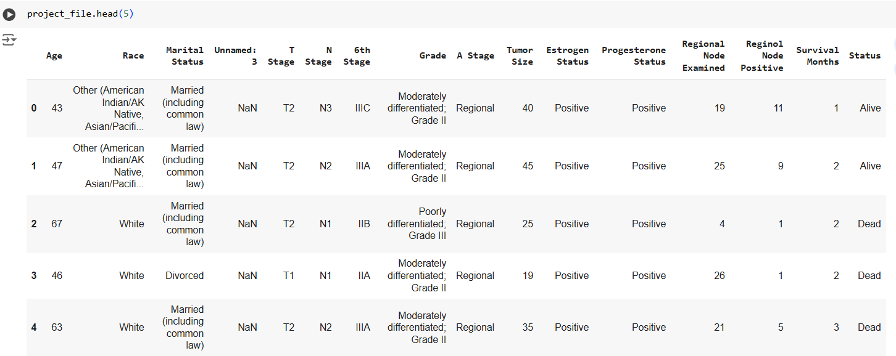
Dataset

Slide 8
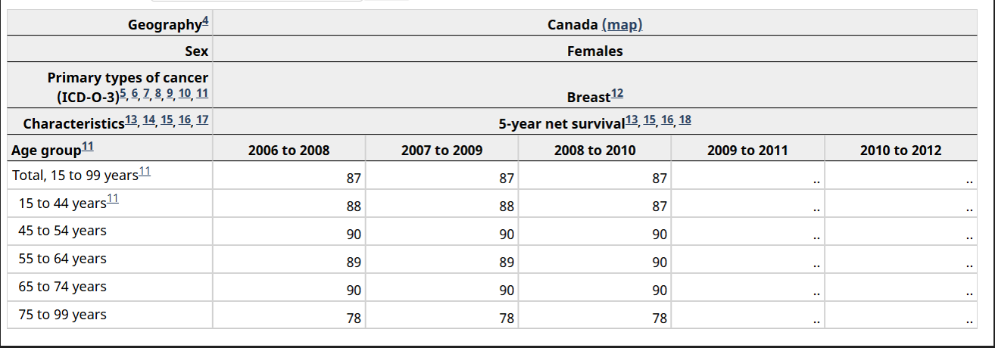
Tabular data

Slide 9
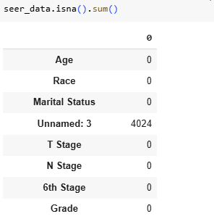
Data Cleaning
Find out the missing values and remove columns having a high number of missing values.

Slide 10
Data Transformation
Find out the datatype of each column as non-numeric data can cause problems in calculations.
The last column of the dataset contains categorical values : ‘Alive’ and ‘dead’.

Slide 11
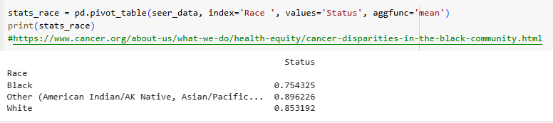
Creating Pivot tables
Group the data to best address the guiding questions
The below code creates a pivot table which will help us answer the guiding question: survivability vs race

Slide 12
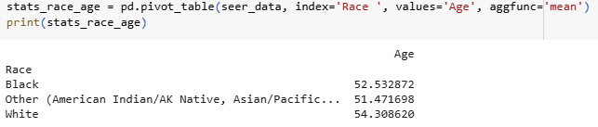
Creating Pivot Tables
To ensure the mean age of the demographics are not too far apart, we can construct another pivot table using age as the values.

Slide 13
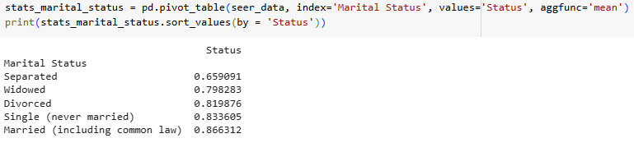
Some more pivot tables
The last pivot table will be created based on the survivability rate vs marital status

Slide 14
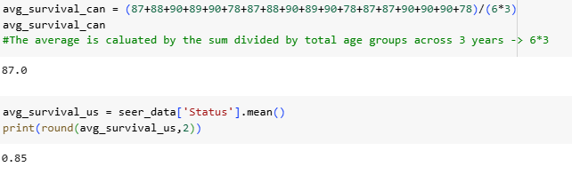
Summarizing the data
Comparing the data obtained from statCan with the SEER dataset:
Find the average of each of the dataset to compare them

Slide 15
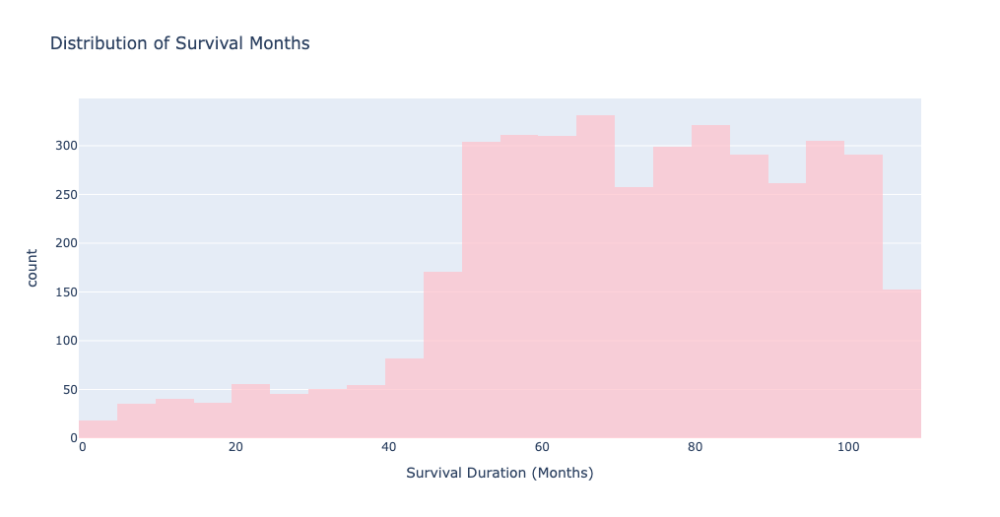
Distribution of survival months
This histogram shows the spread of survival over the months for all patients. Peaks show typical survival times.

Slide 16
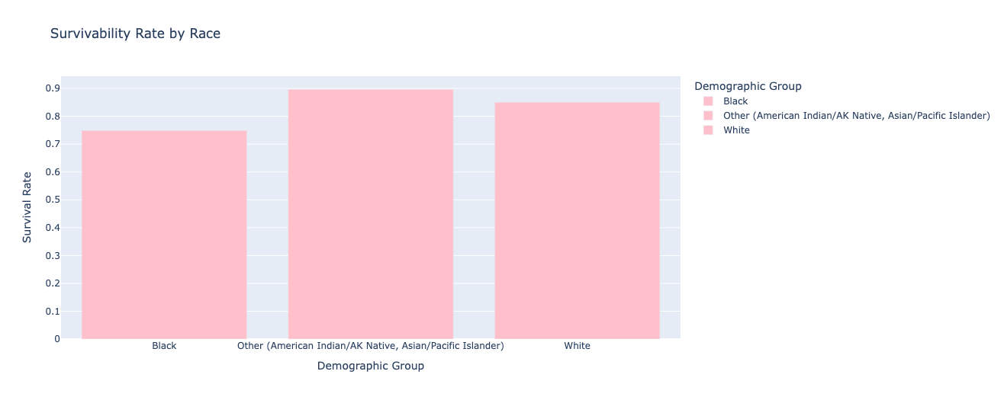
Survival Rates By Race
The average survival rates for each demographic group. A higher survival rate means a larger number of survivors in that specific demographic group.

Slide 17
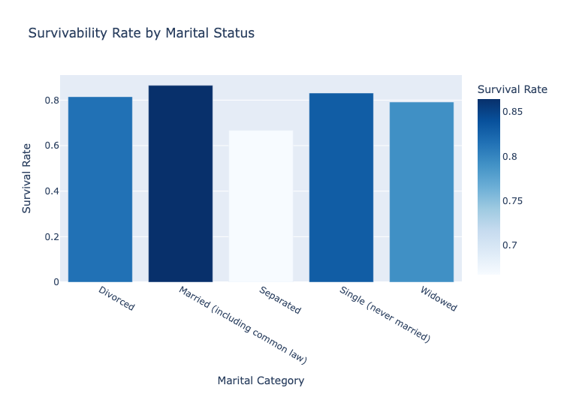
Survival Rates By Marital Status
Description: This bar chart shows survivability rates across martial categories.

Slide 18
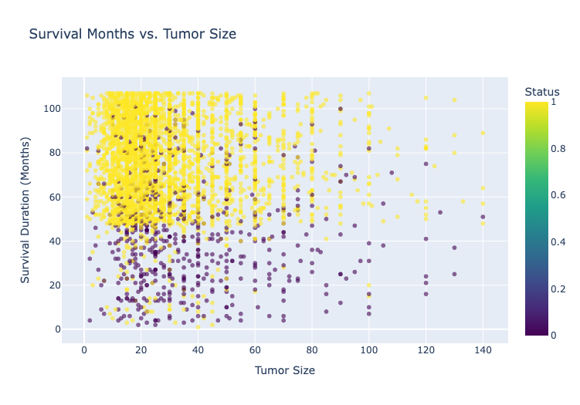
Survival months vs tumor sizes
This scatter plot shows survival duration in months across tumor sizes. Each dot represents a patient.

Slide 19
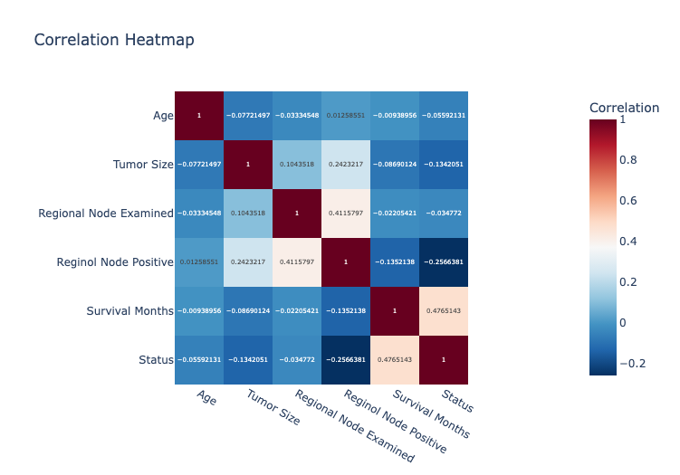
Correlation heatmaps
This heatmap shows the correlation between key variables, such as Tumor Size, Regional Node Examined, Survival Months, and Survival Status. Darker colors indicate stronger relationships.

Slide 20
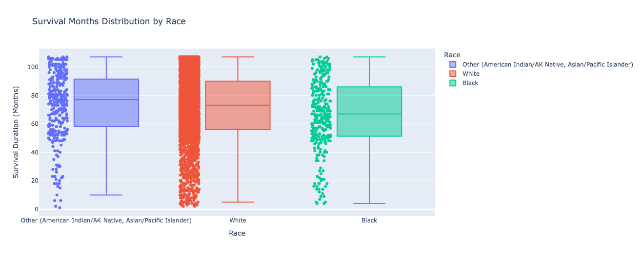
Survival months distribution by race
This box plot shows the distribution of survival months across different racial groups.

Slide 21
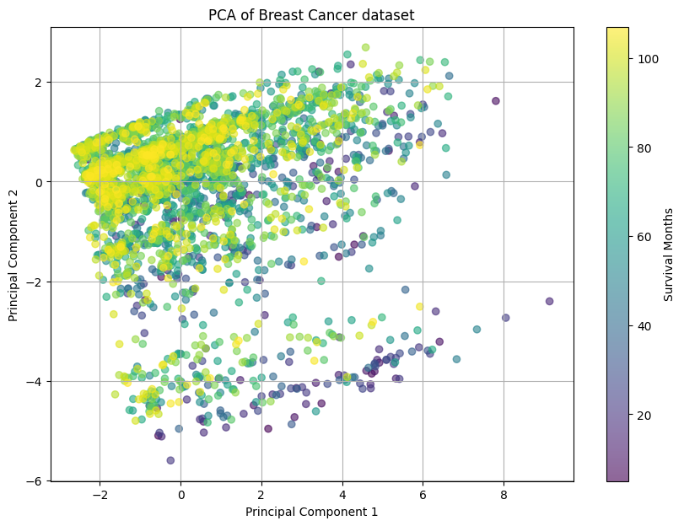
The data after PCA

Slide 22
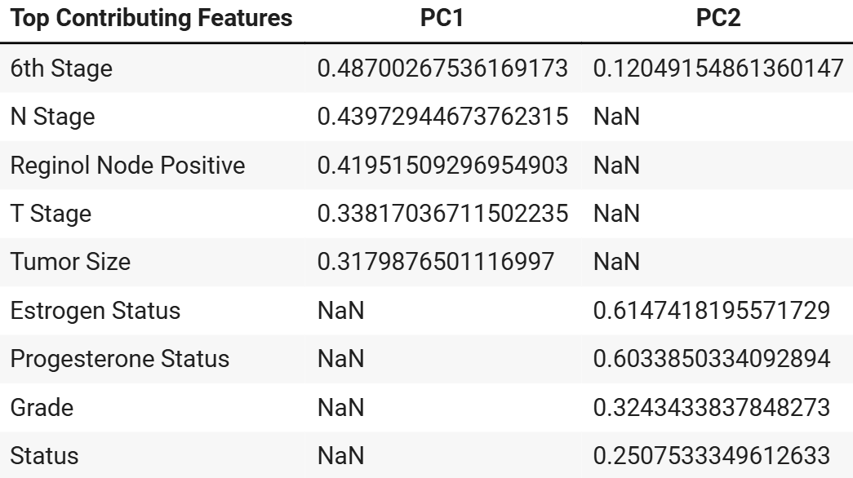
What are the influencing factors?
The number of principal components have been set to 2. These principle components are having a variance ratio of 26.42% and 11.60%. The features contributing to the principle components have listed below with their respecting PCA component loggings(Eigenvector values).

Slide 23
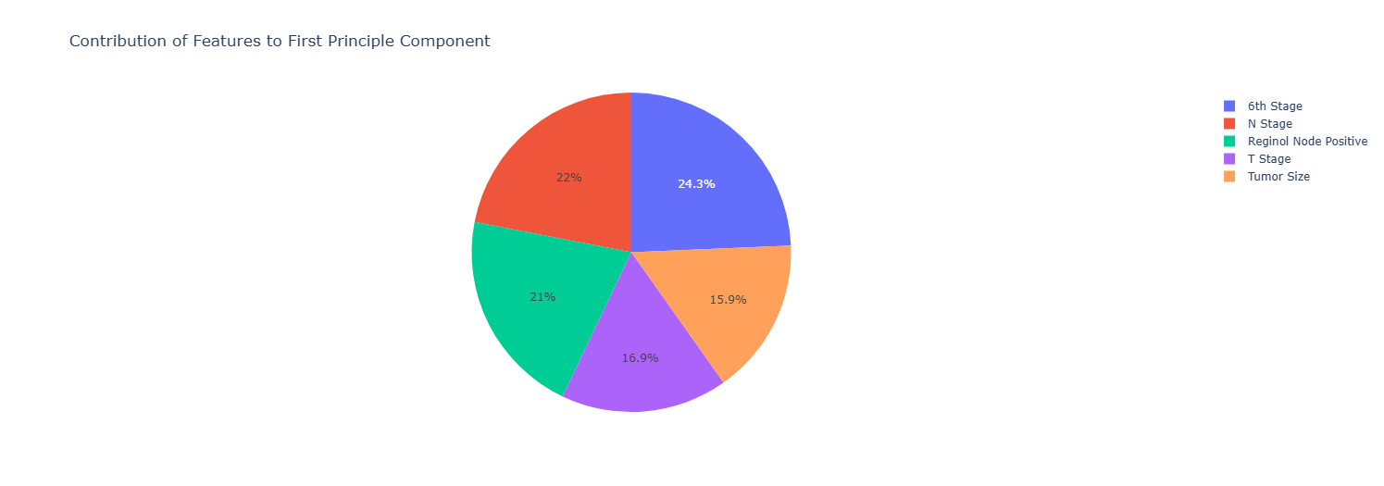

Slide 24
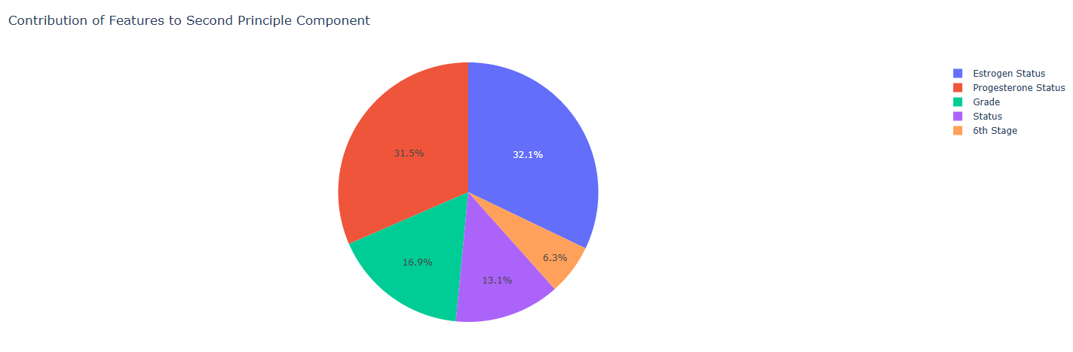

Slide 25
Conclusion
Canadian health data is impossible to find
Race and marital status affect survivability
Tumor sizes, lymph node involvement, and tumor position correlate with survivability

Slide 26
Recommendations
Promote Early Detection and Screening Programs
Address Racial Disparities in Healthcare
Strengthen Social Support Programs
Conduct Further Research on Socioeconomic and Genetic Factors

Slide 27
References:
Datasets
SEER dataset - JING TENG, 2019. SEER Breast Cancer Data. Available at: https://dx.doi.org/10.21227/a9qy-ph35.://ieee-dataport.org/open-access/seer-breast-cancer-data
Statistics Canada (2025). Table 13-10-0158-01 Age-specific five-year net survival estimates for primary sites of cancer, by sex, three years combined. Available at: https://doi.org/10.25318/1310015801-eng (Accessed 07 02 2025).
Articles and research papers
American Cancer Society (Year). Cancer disparities in the Black community. Available at: https://www.cancer.org/about-us/what-we-do/health-equity/cancer-disparities-in-the-black-community.html (Accessed 07 02 2025).
Aizer, A.A., Chen, M.H., McCarthy, E.P., Mendu, M.L., Koo, S., Wilhite, T.J., Graham, P.L., Choueiri, T.K., Hoffman, K.E., Martin, N.E., Hu, J.C. and Nguyen, P.L. (2013) 'Marital status and survival in patients with cancer', Journal of Clinical Oncology, 31(31), pp. 3869–3876. doi:10.1200/JCO.2013.49.6489.
Mir, A. (Year) ‘15 Best Countries for Cancer Treatment’, finance.yahoo, 11 May [online]. Available at: https://finance.yahoo.com/news/15-best-countries-cancer-treatment-113926880.html?guccounter=1 (Accessed: 07 02 2025)
Comparisons of Health Care Systems in the United States, Germany and Canada- https://pmc.ncbi.nlm.nih.gov/articles/PMC3633404/#sec10
National Cancer Institute (n.d.) SEER cancer statistics - AJCC 6th edition staging, Surveillance, Epidemiology, and End Results Program. Available at: https://seer.cancer.gov/seerstat/variables/seer/ajcc-stage/6th/ (Accessed: 07 02 2025).
Canadian Cancer Society (n.d.) Breast cancer risks, Available at: https://cancer.ca/en/cancer-information/cancer-types/breast/risks (Accessed: 07 02 2025).
Python Libraries - Pandas, Matplotlib, Regex, plotly

Slide 28
THANK YOU!

